Slide 1






BlockChain
Workshop Day 2

Slide 2
Bitcoin

Slide 3
BEFORE THAT

Slide 4

Money

Slide 5
Who controls all of the world’s money?

Slide 6
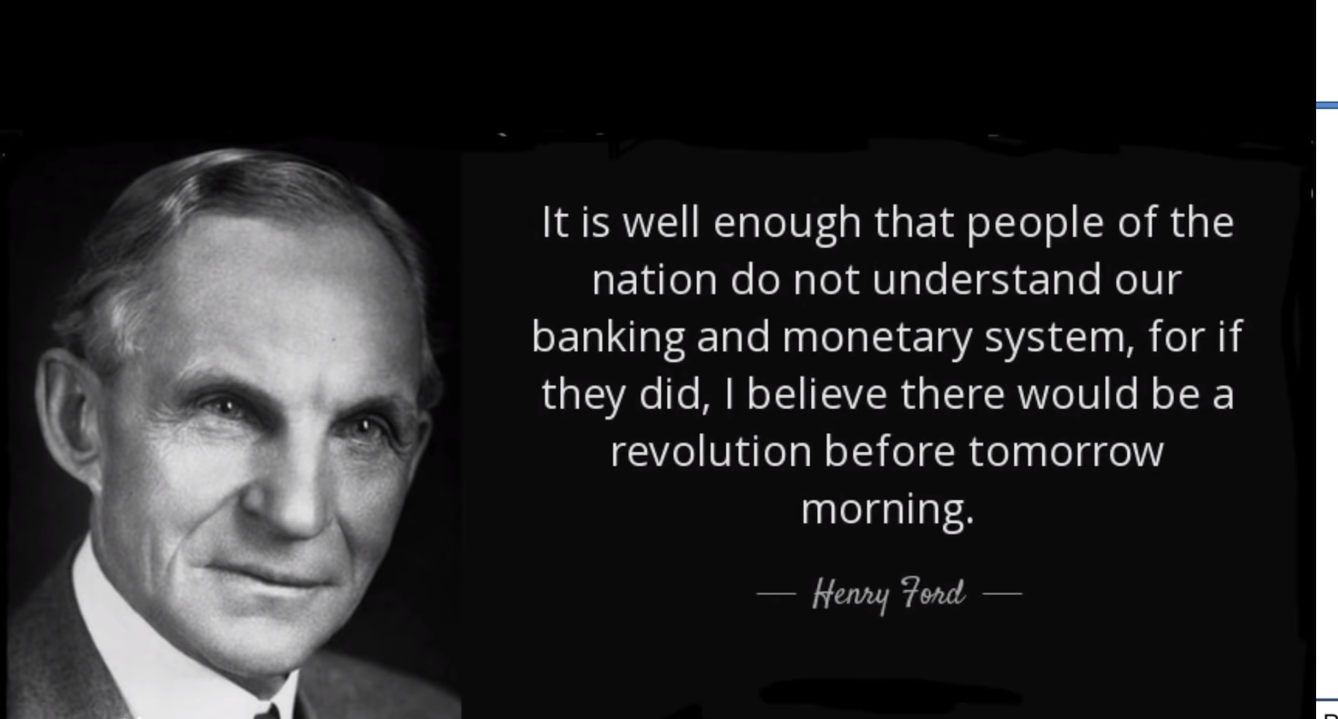
Makes much more sense after this section.

Slide 7
Give a man a gun, he’ll rob the bank
Give a man a bank, he’ll rob the world

Slide 8
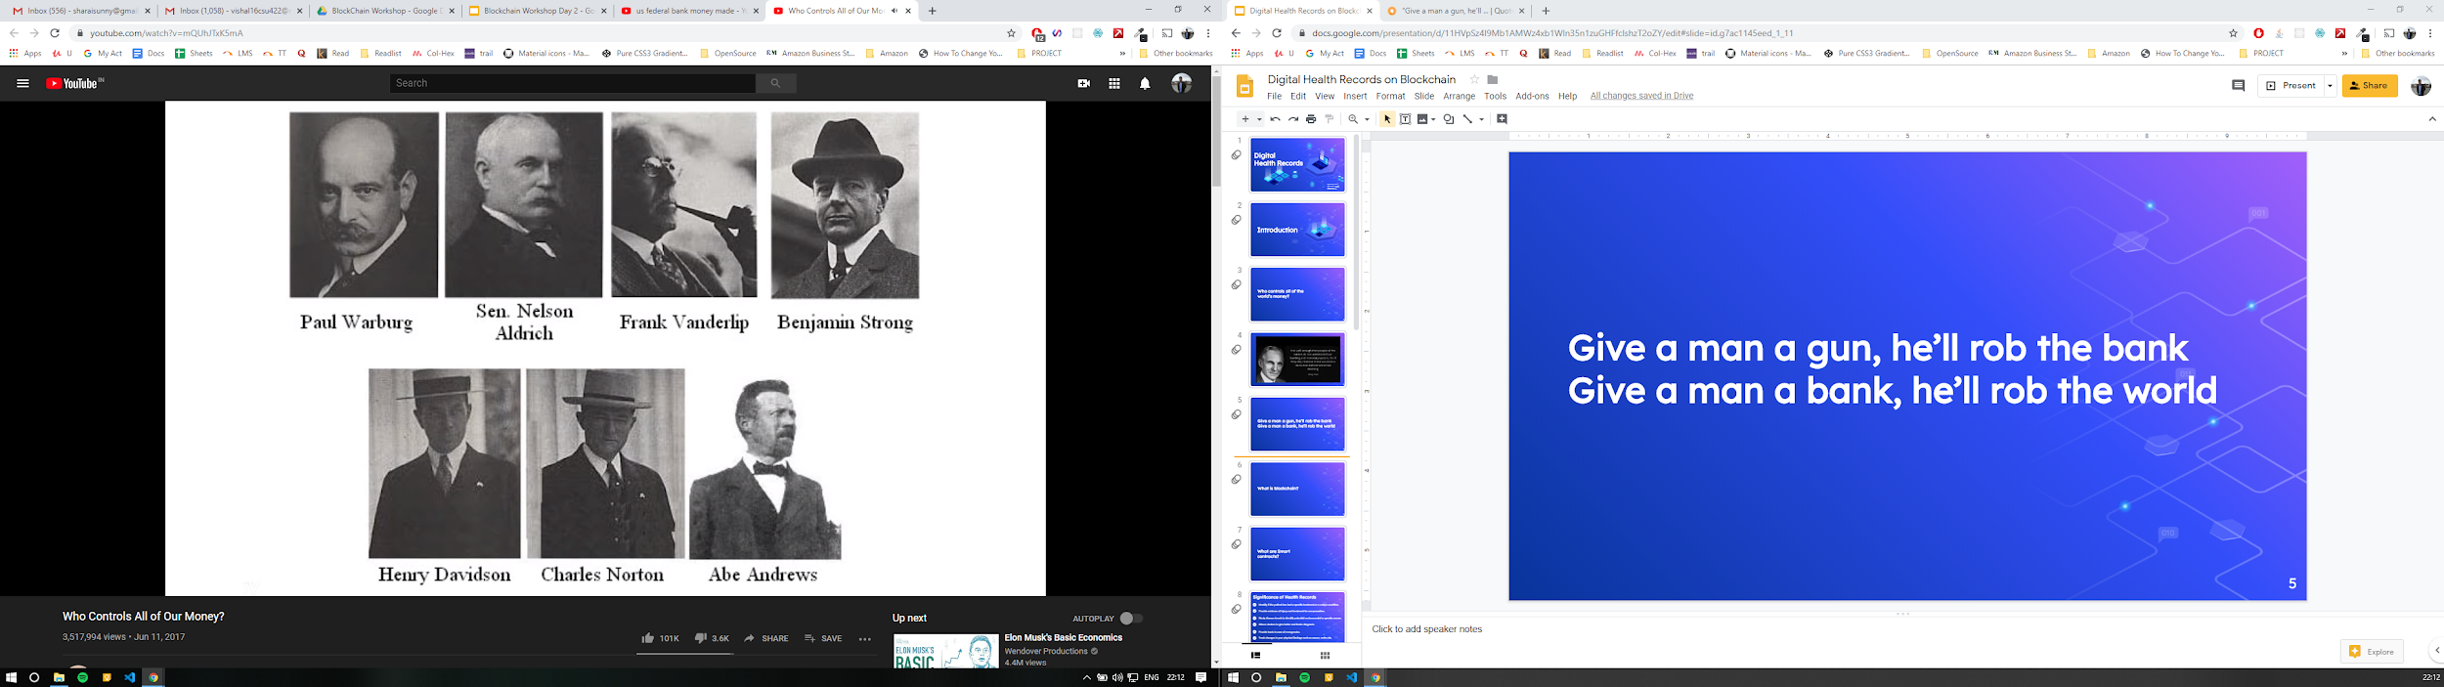
1910

Slide 9
Federal Reserve Act, 1913
Aldridge Bill
Passed - 23 December 1913

Slide 10
How does this affect me?
USD - Reserve Currency since WW2

Slide 11
USD was backed and exchanged for gold
1971 due to falling USD and Vietnam

Slide 12
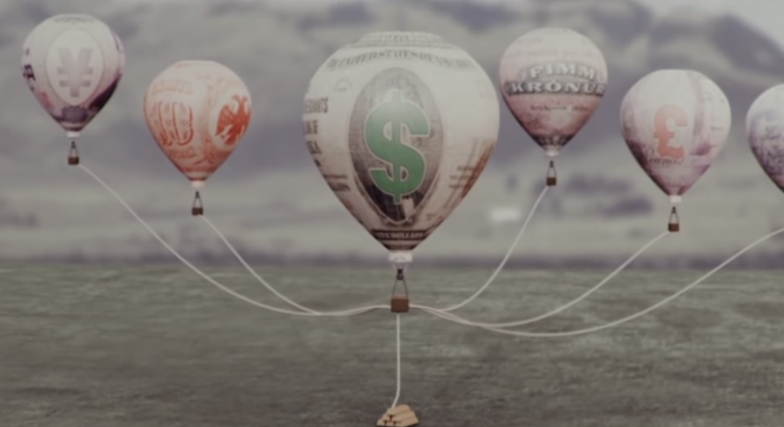

Slide 13
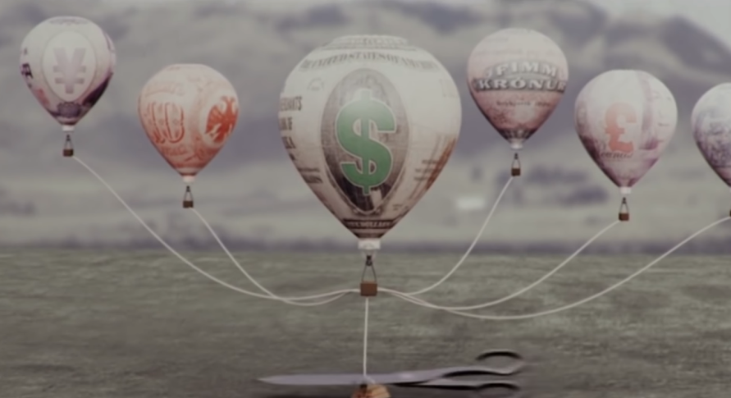

Slide 14
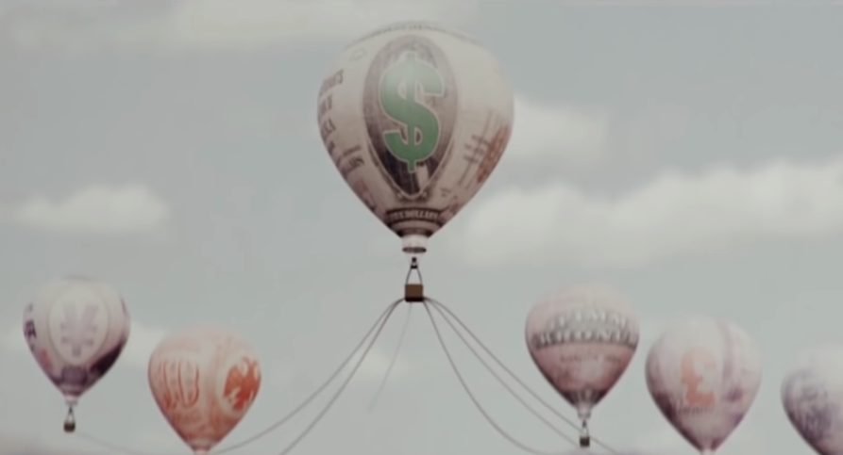

Slide 15
All currency backed by trust in US Govt.
1971 due to falling USD and Vietnam

Slide 16
Creating money out of thin air

Slide 17
Banks do the same
97% is digital money that was created
3% hard cash
Banks allowed to give 10x they have

Slide 18
Why should it bother you?
Inflation
US Economy down, world economy ???

Slide 19
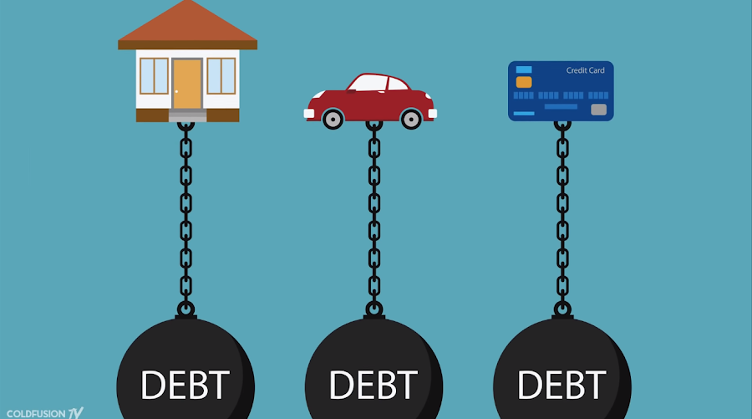
Debt economy

Slide 20
How does Federal bank control money
2000 - Interest Rate cut to 1% to fight recession from .com bubble
People starting taking loans and buying/paying mortgages
Money went up and people thought they were getting rich
RESULT: 2008

Slide 22
Tokens
TRX,AE SNT
ACAT,TNC
WCT WGR
1
Protocol / Coins
Waves Ethereum Bitcoin Neo Ripple
2
BlockChain
The Underlying technology over which Coin and Tokens are created.
3

Slide 23
What is bitcoin?

Slide 24

Satoshi Nakamoto

Slide 25
Why bitcoin?

Slide 26
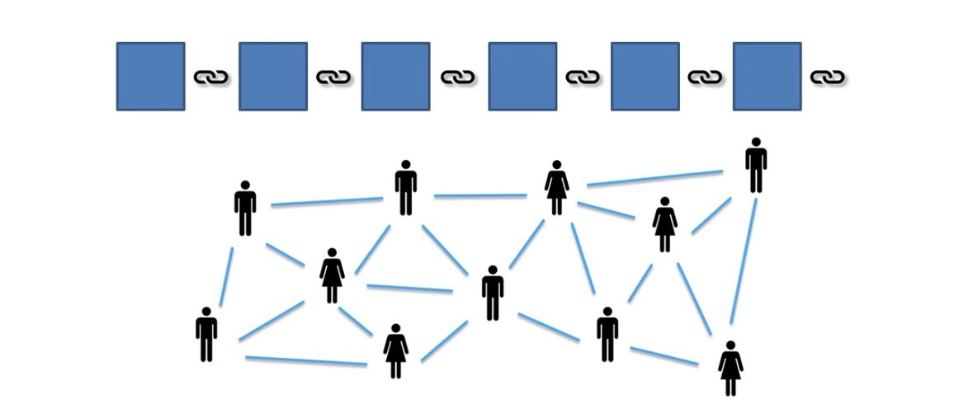
What is bitcoin?

Slide 27
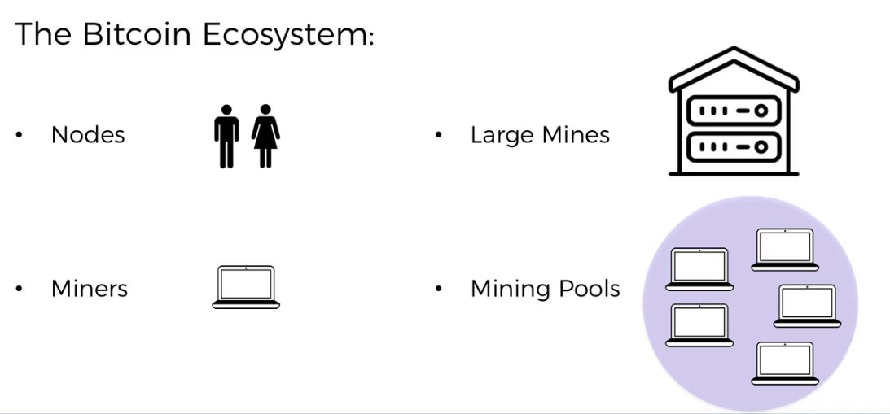
Why bitcoin?

Slide 28
Bitcoin’s Monetary Policy

Slide 29
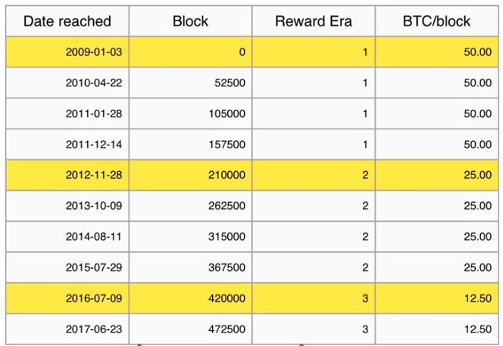
The Halving

Slide 30
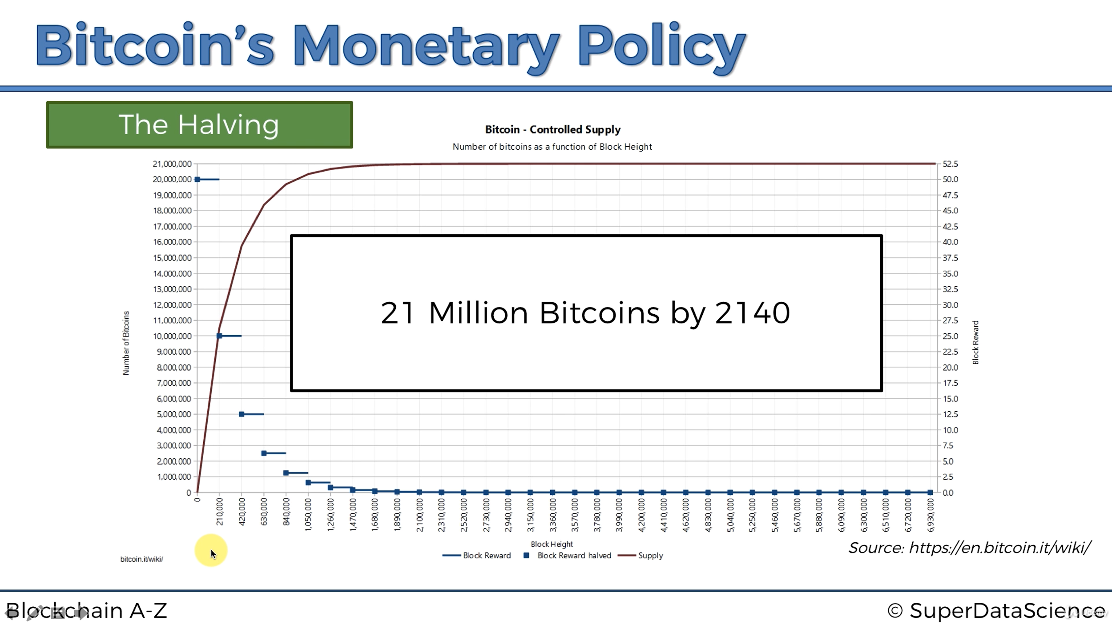
The Halving

Slide 31
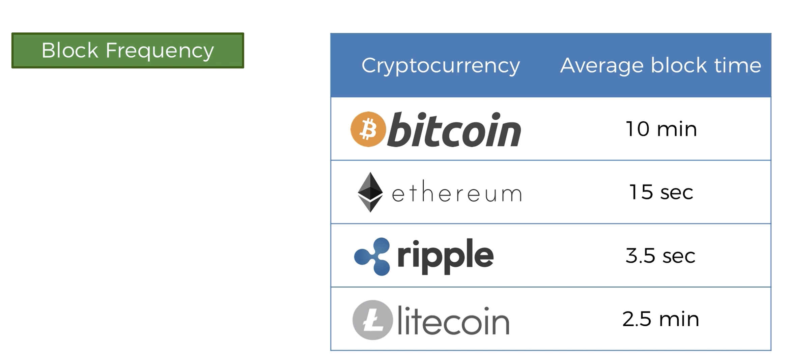
Block Frequency

Slide 32
Mining Difficulty

Slide 33
Current Target
Reducing possible number

Slide 34
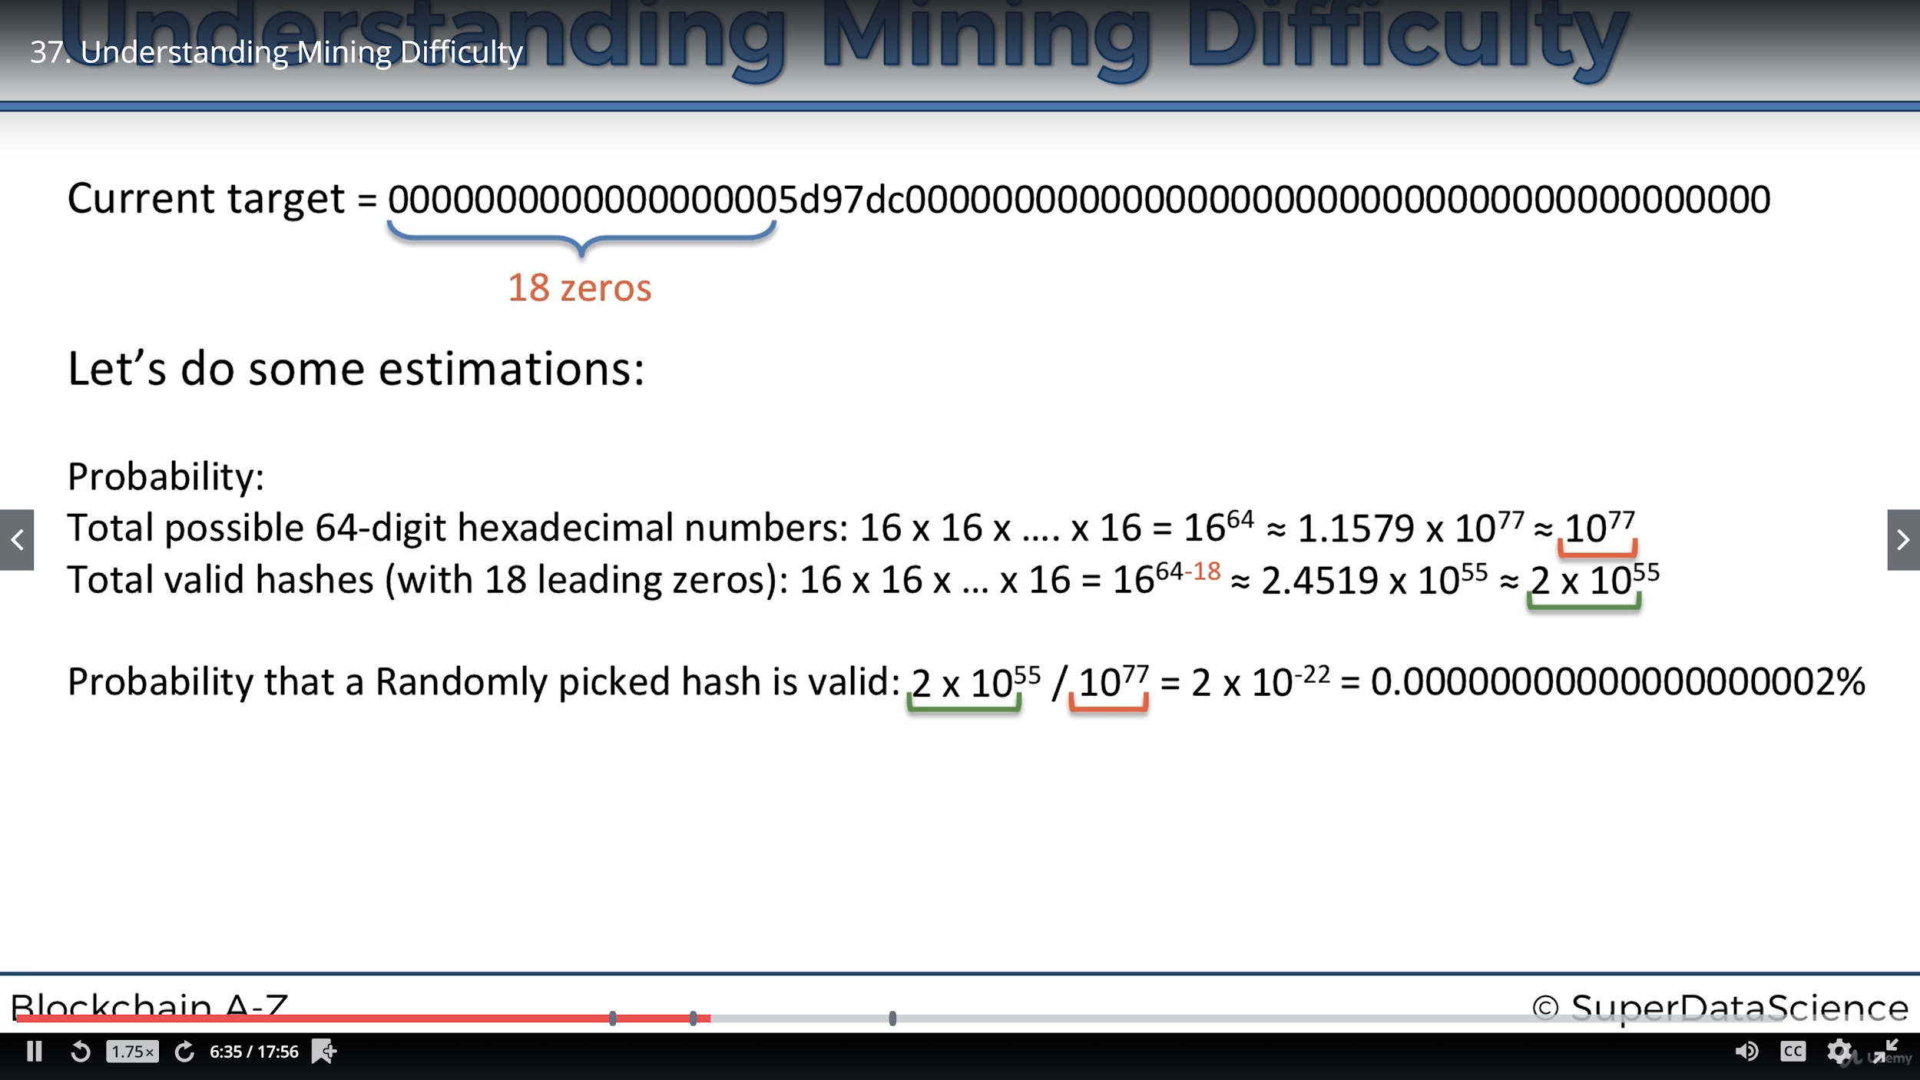

Slide 37
Mining Difficulty Explained
Needs to be adjusted because of increasing miners

Slide 38
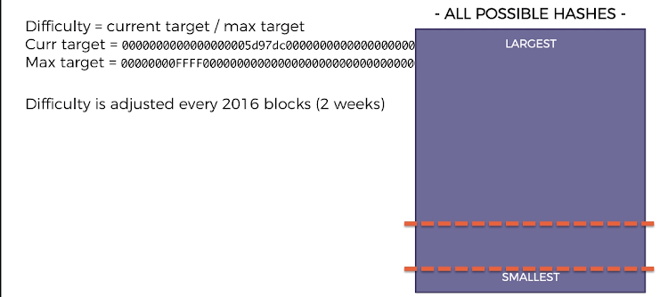
Difficulty is adjusted by the protocol

Slide 39
Mine tour

Slide 40
How can you mine?
Mining Pools
How to compete

Slide 41
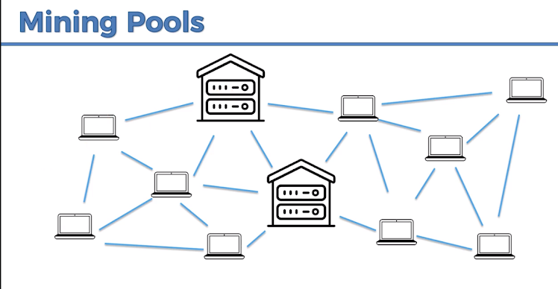

Slide 42
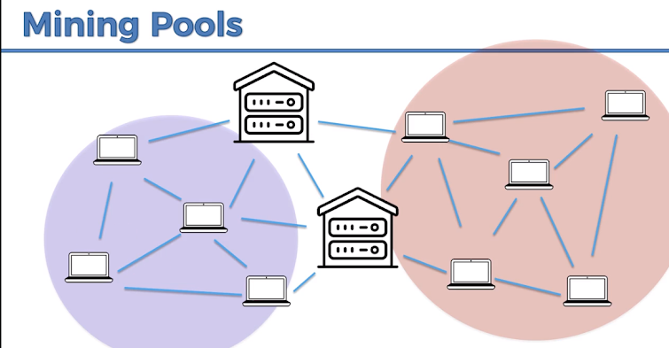
Split over computing power
Hashrate charts

Slide 43
If bitcoin network were a country it would be the 41st consumer in the world

Slide 44
Nonce Range

Slide 45
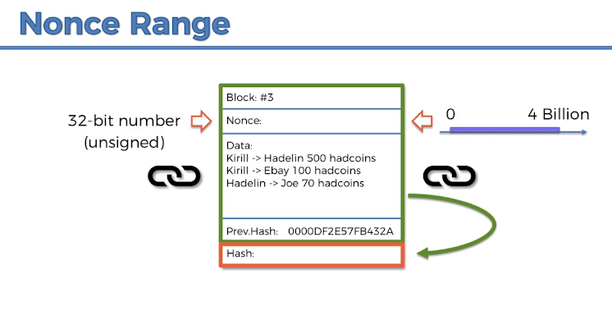

Slide 46
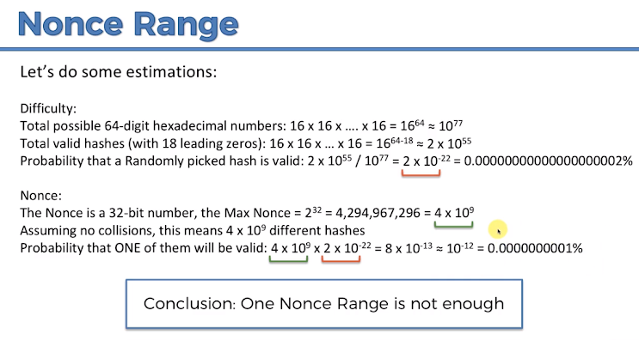

Slide 47
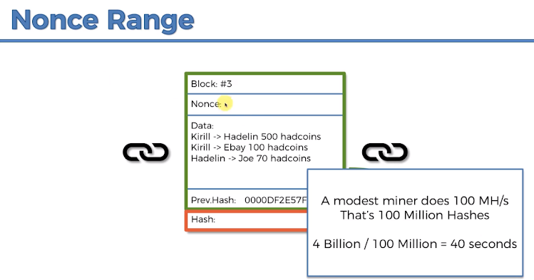

Slide 48
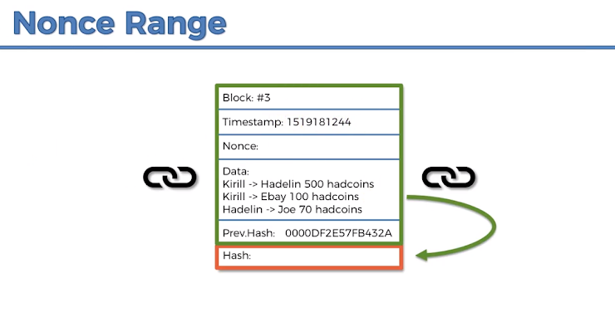

Slide 49
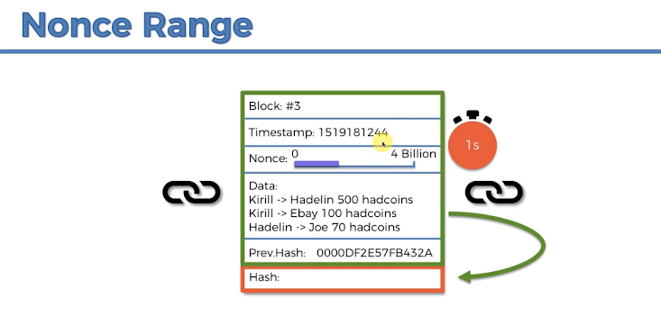

Slide 50
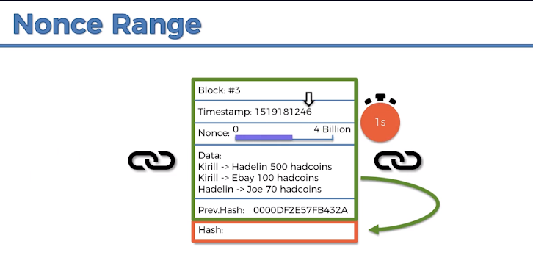

Slide 51
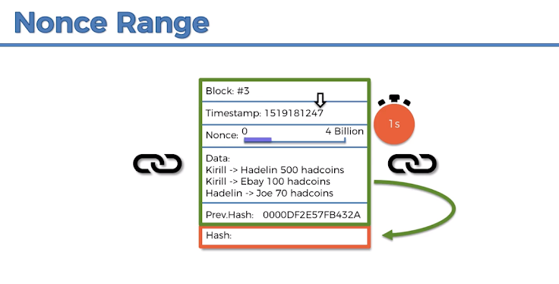

Slide 53
Mining Pool Hash Rate?
What do miners do when they get the nonce in less than 10ms

Slide 54
How miners pick transactions?

Slide 55
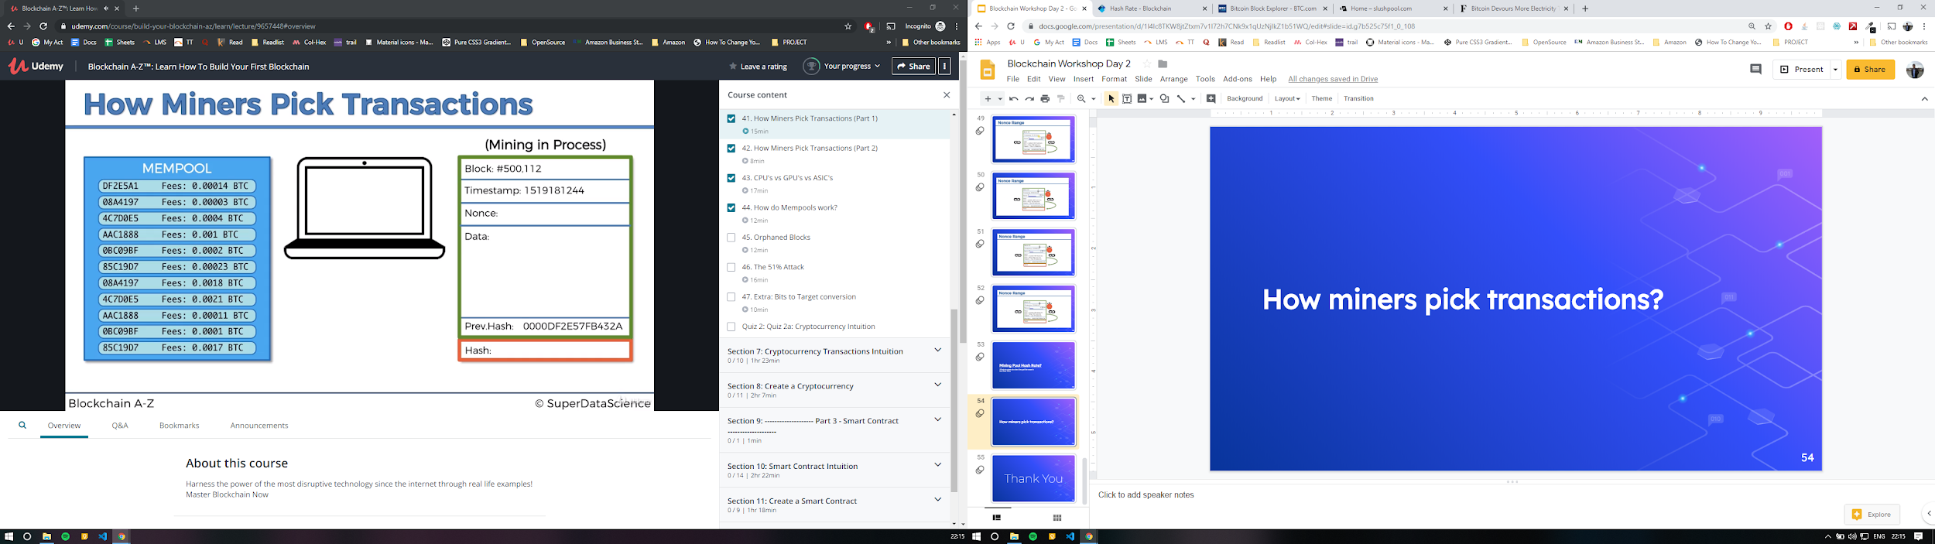
Miners can only put about 1 mb or 2000 transactions in a block

Slide 56
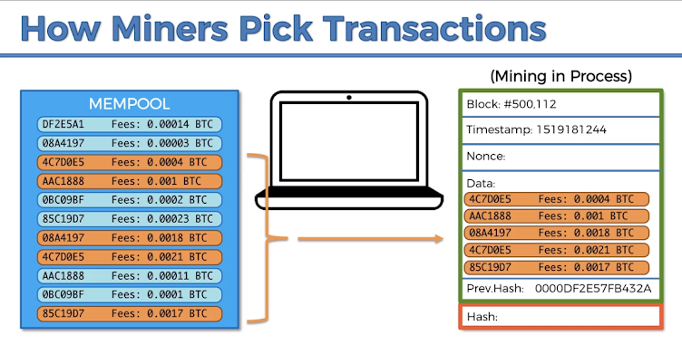
Picking the ones with the highest fees

Slide 57
Picking the ones with the highest fees

Slide 58
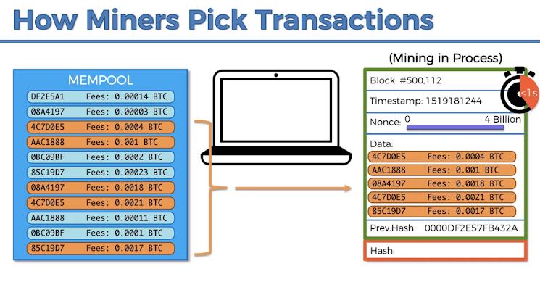

Slide 59
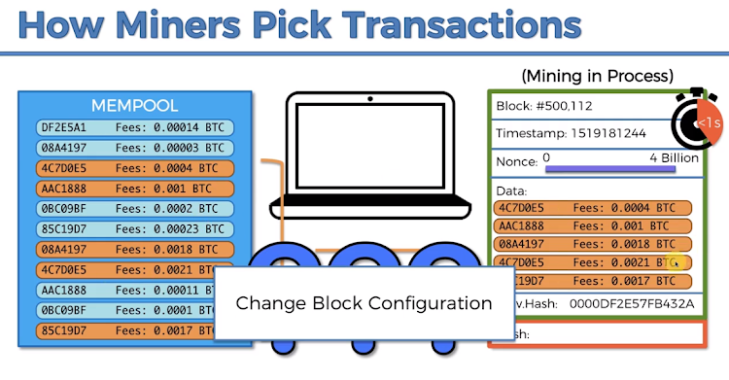

Slide 60
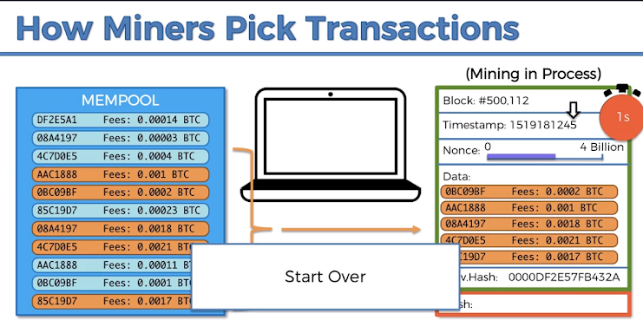

Slide 61
How much did miners make in fees?

Slide 62
How do MemPools work?

Slide 63
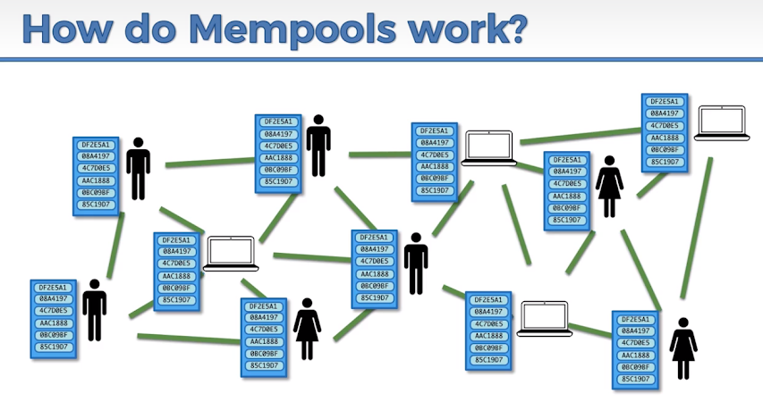

Slide 64
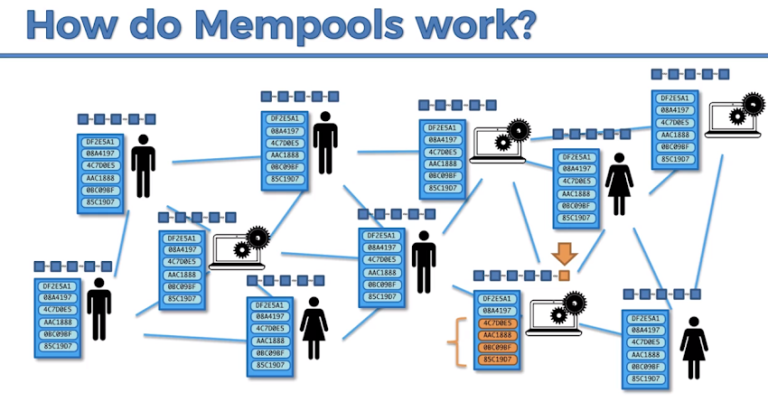

Slide 65
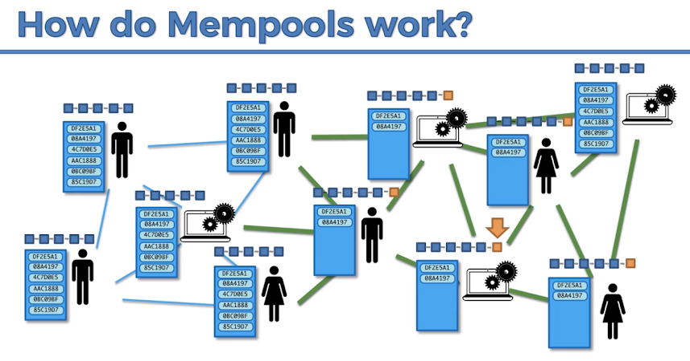

Slide 66
Orphaned Blocks

Slide 67
Transactions in CryptoCurrency

Slide 68
Transactions and UTXOs
Unspent Transaction Outputs

Slide 69
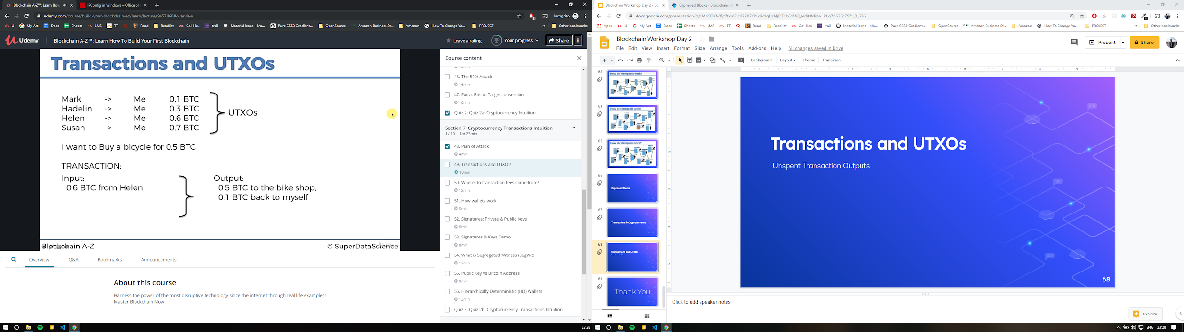

Slide 71
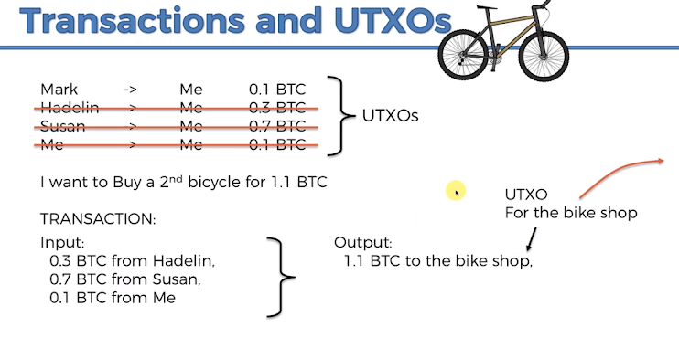

Slide 72
Transaction Fees

Slide 73
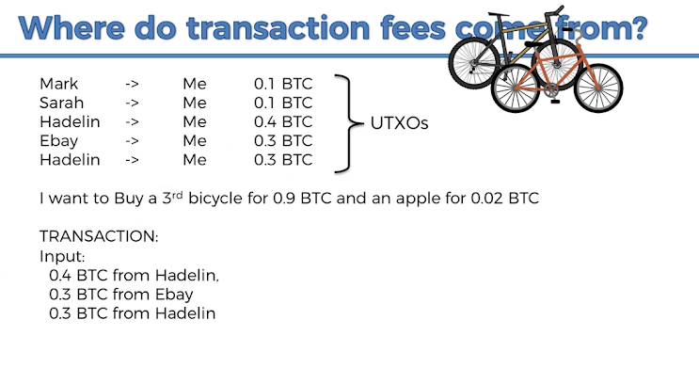

Slide 74

Real life transaction click here

Slide 75
Wallets

Slide 76
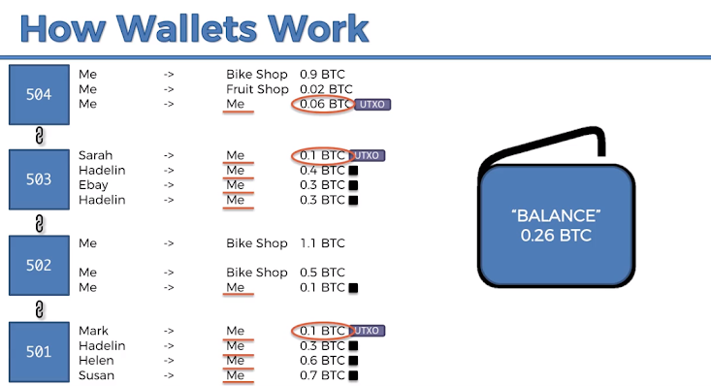

Slide 77
Public & Private Keys

Slide 78
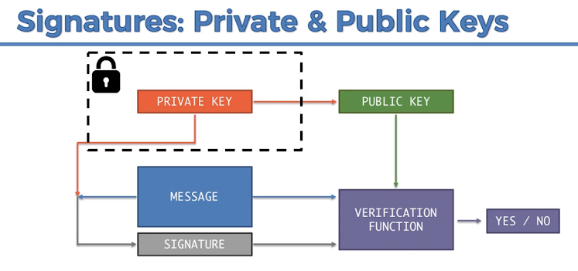

Slide 79
Demo

Slide 80
Thank You

